Slide 1
Towards a Smokefree Generation:
A Tobacco Control Plan for England
South West Clinical Senate
21 September 2017
Allan.Gregory@phe.gov.uk

Slide 2
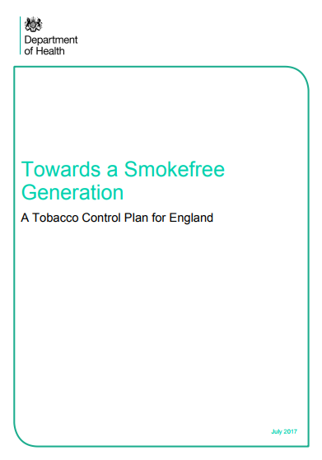
Towards a smokefree generation
PHE have supported the plan throughout its development.
Within days of his appointment, the Public Health Minister made a commitment on the floor of the house, for the plan to be published before recess.
A new Government Tobacco Control Plan for England was published on 18th July 2017.

Slide 3
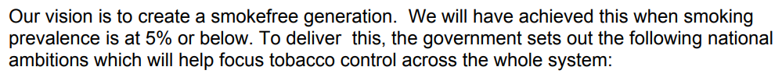
National ambitions
Reduce adult smoking rates from 15.5% down to 12% or less.
Reduce the prevalence of smoking in pregnancy from 10.7% to 6% or less
Reduce the prevalence of 15 year olds who regularly smoke from 8% to 3% or less.
Reduce the inequality gap in smoking prevalence between those in routine and manual occupations and the general population.

Slide 4
We have made progress, but plan to go further
2003: Advertising ban in force
2007: Age of sale rise
2012-15: Display ban in force
Advertising ban generation turns 15
2016: Standard packs
Display ban generation
turns 15

Slide 5
Action
To achieve the ambitions, the new tobacco control plan is targeted around four main themes, with a range of commitments and actions for each.
It sets out the roles of PHE and NHS England in providing national leadership, and the need for close partnership working across local healthcare systems to deliver targeted, evidence-based interventions to support smokers to quit.
Prevention first
Supporting smokers to quit
Eliminating variations in smoking rates
Effective enforcement

Slide 6
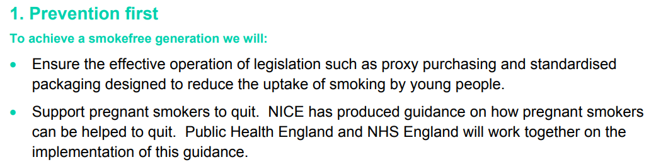
Actions

Slide 7
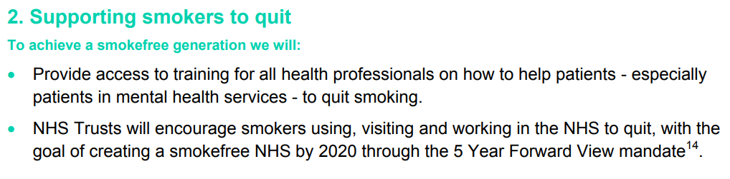
Actions

Slide 8
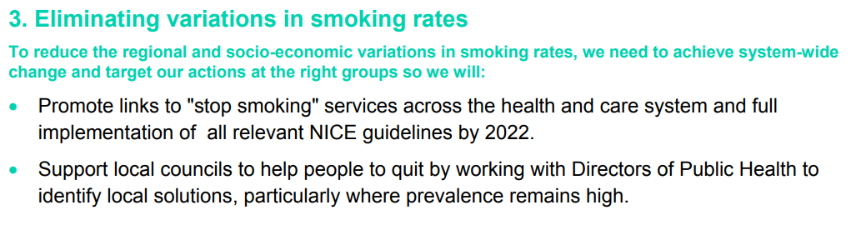
Actions

Slide 9
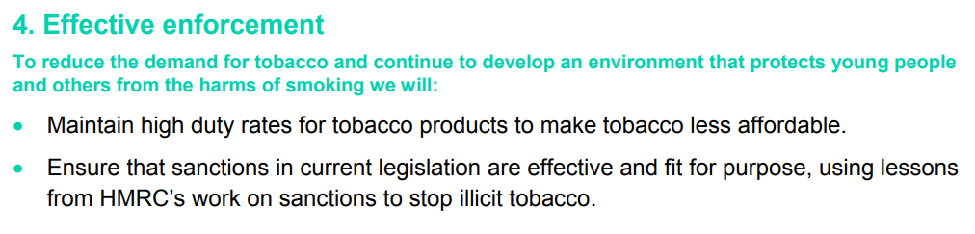
Actions

Slide 10
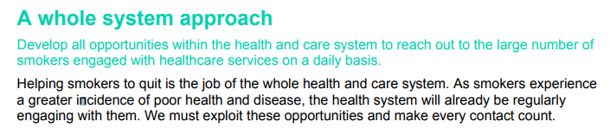
Golden Threads…
Reducing Inequalities
NHS Sustainability
Targeting priority populations
Emphasis on smokers in the healthcare system

Slide 11
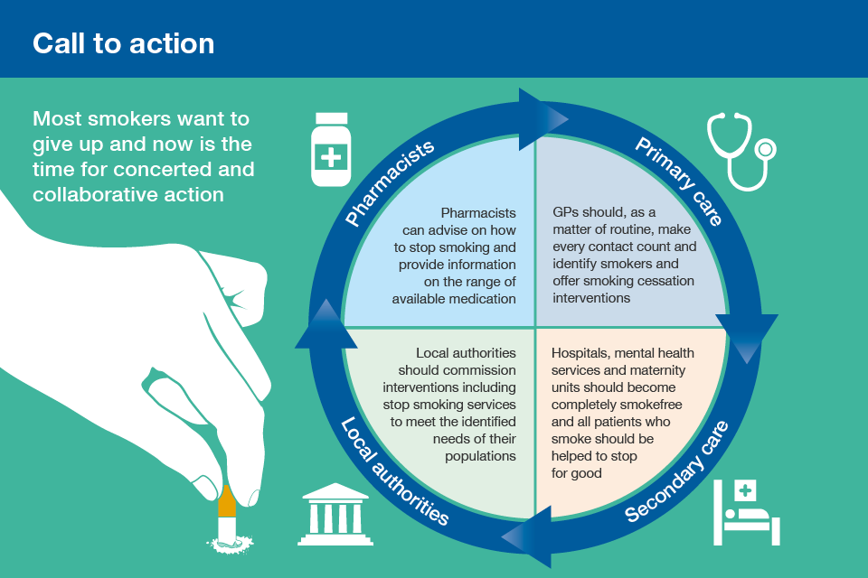
System-wide action

Slide 12
Focus on PHE deliverables
A smokefree NHS
Public campaigns
Supporting local delivery
Nicotine containing products
- Smoking in pregnancy
- Mental health
- Acute / Secondary Care
- Priority populations/ groups
- Evidenced-based interventions
- Training

Slide 13
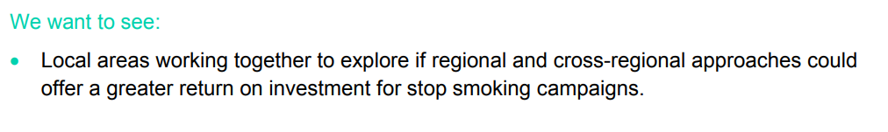
Public Campaigns
PHE will:
Continue to use mass media campaigns to promote smoking cessation and raise awareness of the harms of smoking. This will include the funding and delivery of Stoptober.
Include within quit smoking campaigns messages about the relative safety of e-cigarettes.
PHE and DH will continue to review the effect of marketing campaigns in comprehensive action to reduce smoking and maintain an effective, evidence based approach towards behaviour change marketing.

Slide 14
Nicotine Containing Products
PHE will:
Support local areas looking to implement local smokefree policies differentiating the levels of harm caused by existing tobacco products, e-cigarettes and other novel products.
Update their evidence report on e-cigarettes and other novel nicotine delivery systems annually until the end of the Parliament in 2022 and will include within quit smoking campaigns messages about the relative safety of e-cigarettes.
Continue to provide smokers and the public with clear, evidence based and accurate information on the relative harm of nicotine, e-cigarettes, other nicotine delivery systems and smoked tobacco, to enable informed decision-making. This will include the publication of an assessment of the risks of nicotine addiction.
Provide evidence based guidance for health professionals to support them in advising smokers who want to use e-cigarettes or other nicotine delivery systems to quit.

Slide 15
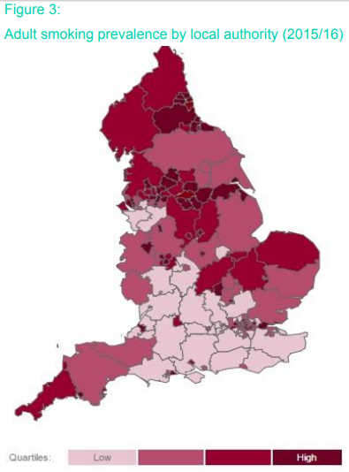
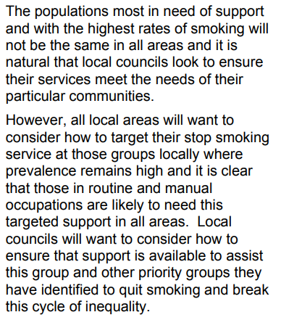
Supporting smokers to quit (1)

Slide 16
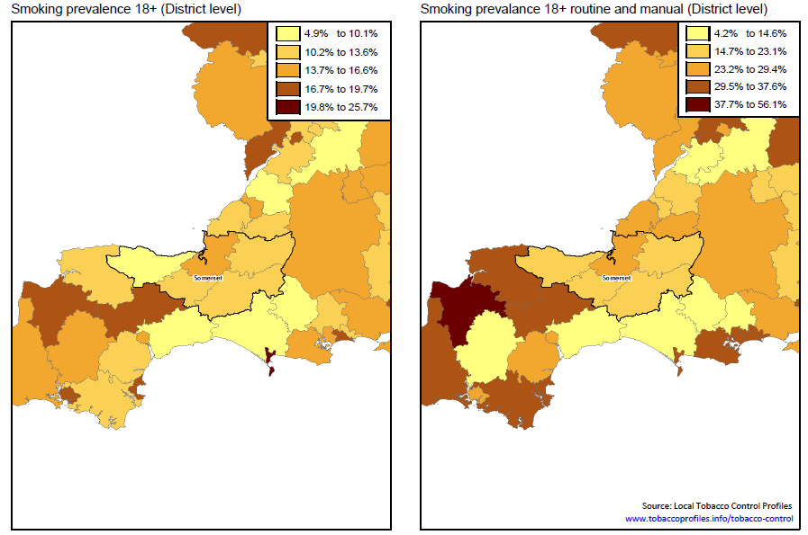
Supporting smokers to quit (1.1)

Slide 17
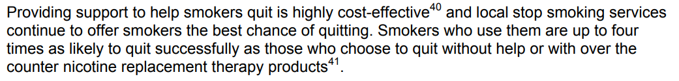
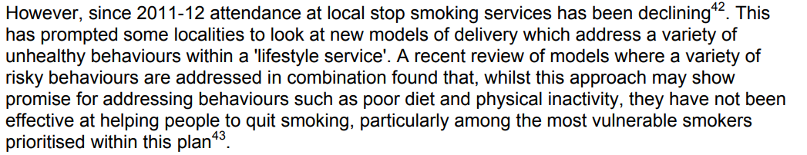
Supporting smokers to quit (2)
PHE to continue to monitor effectiveness of stop smoking services and support local authorities to refocus support to quit
PHE will continue to publish annual JSNA support pack
PHE will target support at those areas with high levels of smoking

Slide 18
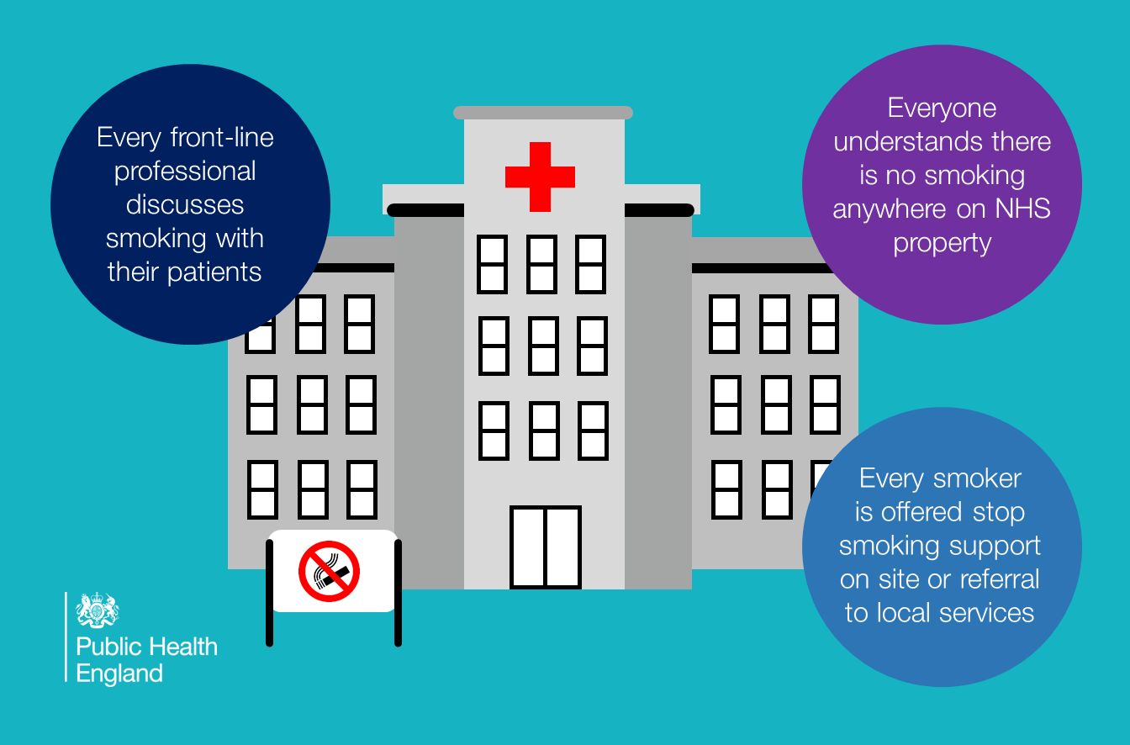
Smokefree NHS

Slide 19
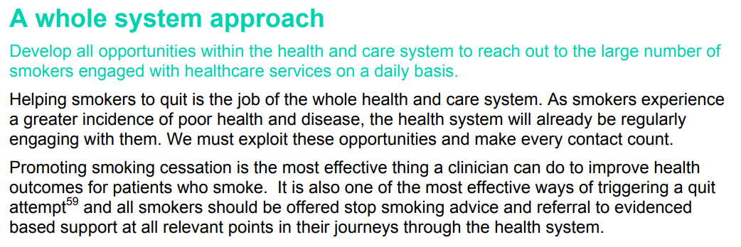
Smokefree NHS
Notes:
Smokefree NHS

Slide 20
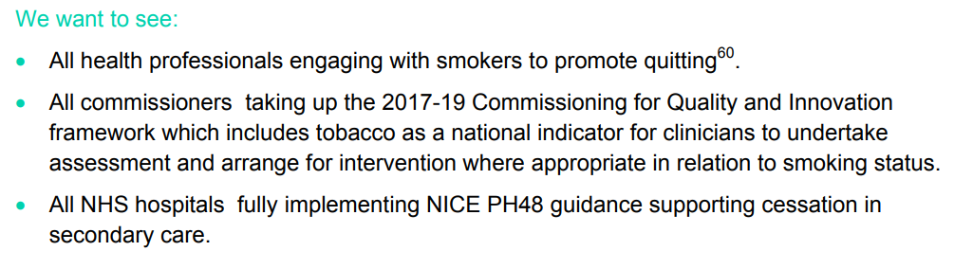
Smokefree NHS
Support NHS England to help smokers using, visiting or working in the NHS to quit.
Support NHS Trusts and secondary care units to implement NICE guidance PH48 on stopping smoking for people using maternity, mental health and acute services

Slide 21
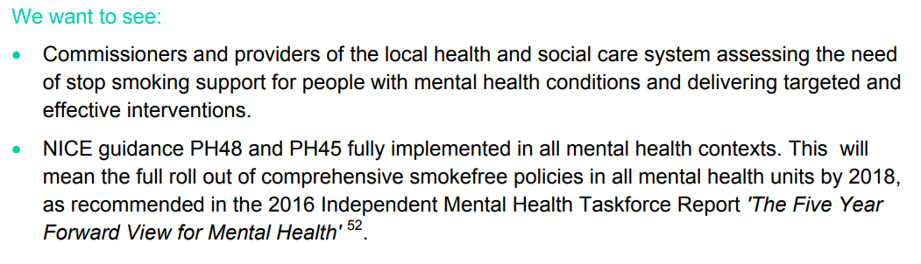
Smokefree NHS (mental health)
PHE and NHS England will develop and disseminate materials to support staff in mental health trusts to implement NICE Guidance PH45 and PH48, which outline the recommendations for reducing the harm from smoking and for helping people stop smoking for people using maternity, mental health and acute services respectively
DH and PHE will identify and rectify gaps in data on smoking and mental health which show prevalence, trends and the level of stop smoking support provided in order to have a comprehensive picture of the problem.

Slide 22
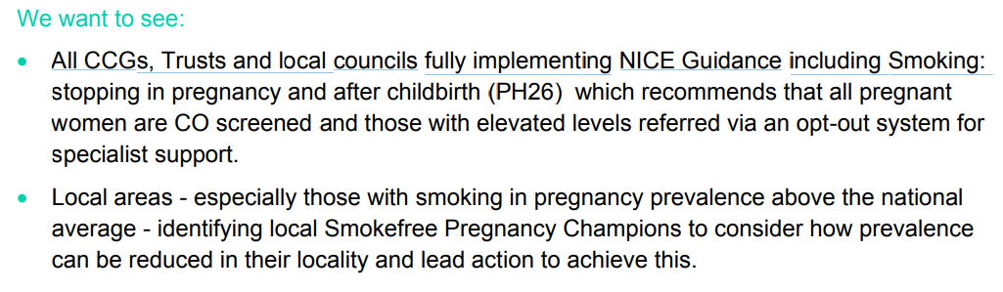
Smokefree NHS (smokefree pregnancy)
PHE will analyse current practice in maternity services, to assess the use of CO monitoring and the implementation of smokefree.
NHSE will work to reduce smoking in pregnancy through CO testing at antenatal care and referral to stop smoking services through the Saving Babies’ Lives Care Bundle
PHE and NHSE to develop a joint work plan setting out recommendations for how local areas can work together to achieve the smoking in pregnancy ambition
Through the MTP, NHS E will work with PHE to reduce stillbirths, neonatal and maternal deaths, by consistently emphasising opportunities to achieve and sustain smokefree pregnancies.

Slide 23
Next steps: implementation
Agree an implementation plan with DH [whole plan]
Partner agencies and localities to develop their own delivery plans.
Implementation events

Slide 24
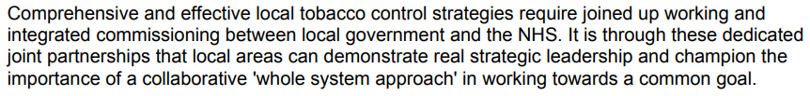
Immediate action regionally
Promote CLeaR Improvement self-assessment tool.
Support the inclusion of tobacco control interventions within local Joint Strategic Needs Assessments and commissioning intentions.
Amplify national marketing campaigns: Stoptober and Health Harms.
Support local systems to deliver a smokefree NHS: via PH48/45/26 compliance and CQUIN initiatives.

Slide 25
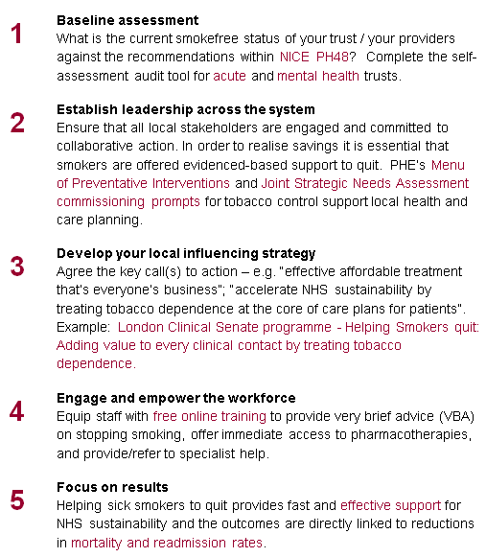
5 steps towards a smokefree NHS: Comprehensive local action

Slide 26
Agree local standards / commitments
[BTS 2017]
All Trusts should have a senior clinician, with clinical programmed activity, to lead a Trust based smoking cessation service and implement the core NICE and BTS standards.
Prescribe all hospitalised patients who smoke nicotine replacement therapy to aid quit attempts and reduce symptoms of nicotine withdrawal, unless contraindicated or patients opt out.
System Leadership / Accountability
PH48 compliance
Delivery of the CQUIN

Slide 27
“Making a million opportunities count”
Tobacco use
Sx’s
Death
10
20
30
40
50
60
Dx &
Rx
[Dr Sanjay Agrawal / British Thoracic Society]

Slide 28
Thank you
allan.gregory@phe.gov.uk

