Slide 1
Louisa Foxwell
Health and Wellbeing Lead
Avon and Wiltshire Mental Health Partnership
NHS Trust

Slide 2
Avon and Wiltshire Partnership covers:
Bath, Swindon, Wiltshire
Bristol, North Somerset, South Gloucestershire
Secure Services
Specialist Services (Mother and Baby, Eating Disorders, Drug and Alcohol,
Criminal justice and more)
CAMHS (Bristol and South Gloucestershire)
Headcount of 4000 staff
Approx. 100 sites
Covering in excess of 2500 square miles

Slide 3
Where we started
Previous organisational strategy was around promoting healthy eating and physical activity, five ways to well being model – as was the national picture

Slide 4
Staff Engagement
6 months plus
Mostly informal, personal, face to face, positive enquiry, really listening to what staff had to say
Drew information of a variety of other sources
Notes:
(and despite having some very diverse services across a huge area, they were saying the same things)
(applications for wellbeing money, staff survey, issues raised across meetings)

Slide 5
Ensure Organisational responsibilities aren’t transferred on to Staff
Notes:
Our main causes of sickness absence are stress and msk
What staff are hearing is; ride a bike, eat a salad etc its your fault your off sick.

Slide 6
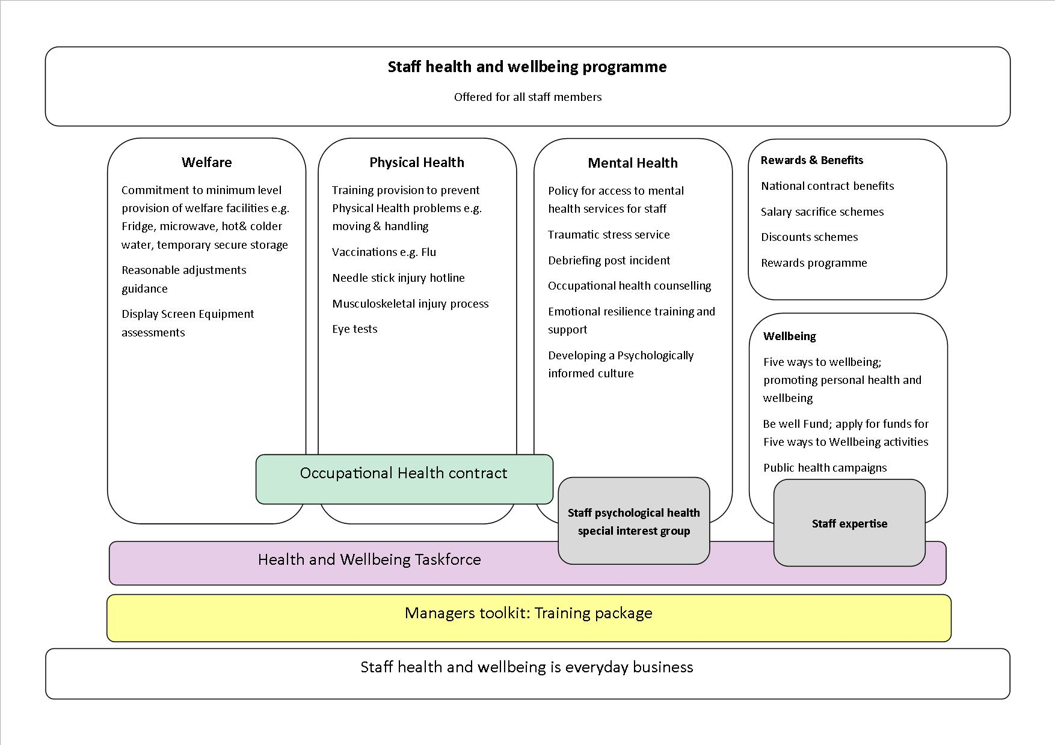

Slide 7
Key:
Taskforce having the right people in the room
For staff to know you are taking action
Challenging but important when you are still working toward having the final package
How staff feel about having the opportunity for involvement is as important as the end result

Slide 8
Staff Support Model
Organisational commitment to ensure
psychological debriefing offered after incidents

Slide 9
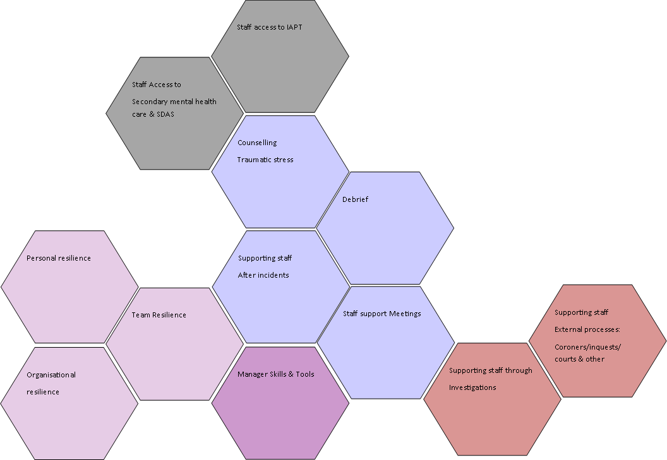
Staff access to IAPT
Staff Access to
Secondary mental health care & SDAS
Counselling
Traumatic stress
Debrief
Personal resilience
Supporting staff
After incidents
Team Resilience
Staff support Meetings
Supporting staff
External processes:
Coroners/inquests/courts & other
Organisational
resilience
Manager Skills & Tools
Supporting staff through
Investigations

Slide 10
Louisa Foxwell
Health and Wellbeing Lead
Louisa.Foxwell@NHS.NET

