Slide 1


CYP Mental Health - a view from HEE
Rachel Wylie
SW Mental Health Lead
Associate Workforce Transformation Lead BNSSG and Somerset
Notes:
Member of the Transformation team.

Slide 2
HEE – CYP MH
Who we are
CYP MH Workforce priority
What we are doing to support current workforce and development of future workforce
National, Regional and Local support
Notes:
Priorty as workstream is increasing
This includes supporting the mental and health well being arena

Slide 3
Our purpose
"Health Education England exists for one reason only: to support the delivery of high quality healthcare and health improvement to the patients and public of England by ensuring that the workforce of today and tomorrow has the right numbers, skills, values and behaviours, at the right time and in the right place."

Slide 4

HEE – CYP MH workforce
MH workforce plan, Stepping Forward to 2020/21: The mental health workforce plan for England (2017).
FYFV
CYP workstream
Notes:
Produced in response to the FYFV in Mental Health
Overview of CYP workstream – which includes health and well being of staff

Slide 5
CYP Workstream
SUPPLY ( + RETAIN)
UPSKILLING
NEW ROLES
LEADERSHIP
NEW WAYS OF WORKING
Notes:
5 pillars which all support work force and overall mandate
National Strategy Feedback – However in SW more of an emphasis of retention.

Slide 6
Supply and Upskill
HEE currently commissions all CYP IAPT training places
The targets over the five year to 2021 are:
  3,400 existing/current staff (UPSKILLING)
  1,700 New therapists (SUPPLY)
This programme is delivered across 6 regional collaboratives and 7 providers
Notes:
through a variety of education providers ensuring that there is an even spread across the country
Exeter University being the local provider

Slide 7
Supply and Upskill (cont.)
The number of therapist who commenced training in January 2018 is:
  247 existing therapist staff training on CYP IAPT modalities (UPSKILLING)
  188 new staff to be created as Recruit to Train posts (SUPPLY)
  191 supervisors from existing staff being trained to develop future capacity (UPSKILLING)
Notes:
HEE are currently working with HEI’s and NHS E to commission training places for 2018/19 and onwards

Slide 8
NEWish ROLE – CYP PWP
Directly commissioned by HEE
Ensuring consistency
Based in existing CAMHs teams
210 commissioned in 17/18
420 per year until 2020/2021
Notes:
The Psychological Well Being Practitioner (PWP) is a newish role specifically aimed at CYP, this again is directly commissioned by HEE who ensure that all such training is delivered to the same high standard across England. This role will contribute to the achievement of the target to recruit more staff. The role is based within existing CAMHS teams and i

Slide 9
Upskilling of other staff
Supply of other staff
CAMHS Psychiatrists
Tier 4 whole team training
Notes:
HEE is working across England to increase the number of CAMHS psychiatrists, by supporting trainees who are interested in this area of work to progress at pace through their training to achieve consultant level. With 8 places being commissioned for this ‘run through’ path for psychiatrists in 2017.
HEE has also recently commissioned Tier 4 Whole Team Training, to ensure whole team seamless delivery of care to CYP with mental health needs. This programme is designed to upskill existing staff and will be delivered across the 6 collaboratives and 7 HEIs, provision is currently being scoped with providers.

Slide 10
NEW DEVELOPMENT
Green Paper
Consultation response to the Government’s CYP Green Paper, due to be published today
HEE already working with DH and is already developing new and innovative ways to develop the workforce.
Based in schools
NEW ROLE - Title not yet confirmed - EMHW, MHSW

Slide 11
MHS / EMHW
  Developed the new curriculum for the MHS role
  Commissioned 7 universities to provide the programme for 210 students; possibility of an 8th provider and a maximum total of 250 students to commence in January 2019
  Currently planning the advertising and recruitment campaign to commence early September
  Developed a proposed 3 year funding model to deliver both the FYFV and the GP agenda.
  Trailblazers to be chosen October 2018
Notes:
Funding will hopefully be confirmed soon.

Slide 12
New Role – Development and support
Clarity on what the role will deliver
An understanding of how the new role will fit into existing teams – for both the trainee and the other members of the team.
Geography/Education
The whole CYP education agenda will need significant management and co-ordination – local resource
Notes:
there are general areas that need to be addressed, as with any new role
One of the criticisms we see with other new roles is that there seems to be little idea of what the role of the trainees will be once qualified – which makes the trainees feel like guinea pigs. It is recognised that with any new role nothing should be set in stone but there should be some guidelines so that the trainees can see that some thought has been given to this.
– hence the request for specific local resources within HEE local offices.

Slide 13
Do not reinvent the wheel
Local plans – guide and share
Regional plans – support and raise awareness
National plans – raise awareness

Slide 14
Utilise Local Initiatives
STP MH Workforce plans – Nov, March, June
Summary – CYP detail improving – service, targets, supply, retention (concern over expectations)
Trying to connect STPs with CYP/CAMHS network
Most mention cross cutting retention plans for MH workers –not specific to CYP MH
Notes:
EG Somerset 24th August conferene

Slide 15
Utilise regional initiatives
SCN - HEE is working with the Strategic Clinical Network to replicate a KSS MH retention project in the South West – Clever together.
Emphasis placed on contributions from CYP
Data cut in different ways
Regional HEE resource to share best practice etc

Slide 16
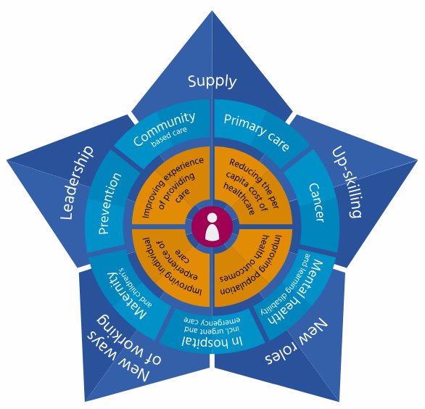
Utilise National Initiatives
HEE STAR MODEL
hee.nhs.uk/our-work/hee-star
Notes:
Second one has just been launched by NHSE and is a diagnostic toll which is being rolled out across the NHS.

Slide 17
Utilise National Initiatives
https://www.mind.org.uk/workplace/ - MIND healthy workplaces programme
NHS E workforce health and well being framework https://www.nhsemployers.org/case-studies-and-resources/2018/05/nhs-health-and-wellbeing-framework.
NHSI work on Retention
Notes:
Second one has just been launched by NHSE and is a diagnostic toll which is being rolled out across the NHS.

Slide 18
Thank you for listening
Any Questions...

