Slide 1
A systemwide approach to reducing long waiters
Dr Amelia Randle
Clinical Lead SWAG Cancer Alliance

Slide 2
Notes:
2 Phases
‘The Golden 28 days’ of cancer diagnosis.
2ww conversion rate of 10% for the sake of easy maths
By the time people are on the active cancer pathway the 28 days is over.

Slide 3
Notes:
We look at the pathway in this sort of way..
As soon as we realise this person is going to need anticancer treatment and are going to count towards 62d target we think of the steps in the pathway and try to make them quicker. More access to scans, streamlining pathways.

Slide 4
d1
d62
Notes:
Instead of thinking of each step individually

Slide 5
Clinical Case
61F
Pancreatic Adenocarcinoma
2ww referral – Oxford Cardiology: abnormal uptake in neck of pancreas on PET scan.
First treatment 154 days later.
Notes:
This is a patient from my surgery who was a long waiter. I thought it would be useful to review her as she really illustrates some of the challenges we are dealing with. I met her for the first time on about day 52 and was struck but how every single step of her pathway seemed to be a challenge. And although there’s a different reason for each delay I was interested to know if there were patient factors underlying the challenges.
Treated at Bath and Bristol – you may recognise her – interesting to get your perspective as this is GP perspective.

Slide 6
What happened in first 28/62d?
d16 Gastroenterology clinic CT scan requested
d42 CT
d43 seen in clinic with CT result
d52 – HB MDT – ref for EUS and FNA
d60 EUS – FNA non-diagnostic
Notes:
Breaking down to the basic step of her pathway – she breached 2ww target, she didn’t get a cancer diagnosis within 28d. Then the next three steps are within a reasonable timescale but she had run out of time and the FNA was non-diagnostic.
I met her for first time here – she’d come to ask for help in getting date for her EUS. I was struck by her journey. How every single step seemed to have been complicated in seemingly unrelated unfortunate events.

Slide 7
Long Wait..
d77 rpt FNA
d85 diagnosis confirmed at OPA
d86 MDT - outcome Oncology
d94 seen in oncology clinic
d96 sees GP for ref for 2nd opinion: London Liverpool Manchester
d154– first dose chemo.

Slide 8
The Bigger Picture
Feb 14 – letter from pt – 10 items of symptoms. Back pain number 9 on list. Clinical picture of fibromyalgia – referred rheumatology diagnosis confirmed. Later complained to GP about rheum saying felt interrogated and was intrusion into her personal life.

Slide 9
? First Onset of Symptoms
April 15 – long letter from patient – 16 symptoms listed.
Top of list:
‘Back aches so deeply and from bottom to top (I could cry) general wearing out pain.’
‘chest heavy, radiates through to my back – I assume from old disc problem’
Going to stay with father for 6 weeks
Seen June July Jan and feb16 – with unrelated problems no mention of back pain.

Slide 10
Route to Diagnosis
Sept 16 retrosternal chest pain – referred cardiology.
Dx non-ischaemic cardiomyopathy tertiary referral to Oxford
PET

Slide 11
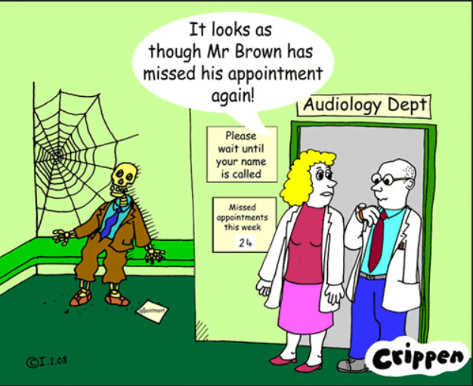
Notes:
Didn’t have LD of mental hlth problem – but we weren’t communicating effectively

Slide 12
Notes:
Medically Unexplained Symptoms and Vague Symptoms of Cancer at the same time

Slide 13
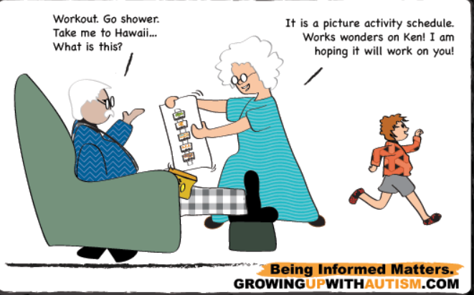

Slide 14
Notes:
Disempowering rather than empowering

Slide 15
Referral
↓
Symptoms ↓
↓ Treatment

