Slide 1
Faecal Immunochemical Testing (FIT). Update on National Roll Out
SW Clinical Senate
27th September 2018
James Bolt, Head of Public Health Commissioning
NHS England South West (South)

Slide 2
Contents
NHSE roles and responsibilities
Why are we introducing FIT testing?
Roll out including demand modelling and capacity planning
Opportunities and Challenges
Next steps
Questions?

Slide 3
The role of NHS England – Section 7A
NHS England has direct responsibility for commissioning services including:
Public Health Services;
Primary Care;
Military and prison health services;
Specialised services.
Public Health functions are set out in Section 7a which include:
Cancer and non cancer screening
Immunisation programmes
Child Health Information Service (CHIS)
Accountable for delivery of the services or programmes it commissions
Full contract and performance management
Quality , Service user & Outcome focused
Supported by embedded Public Health England staff

Slide 4
The role of NHS England – Section 7A Bowel Screening
Commissioners of current gFOBT service
Commissioners of bowel scope screening (flexi sig)
Future commissioners of FIT 120
We don’t directly commission
Surveillance colonoscopies (CCGs)
qFIT (Cancer alliances with CCGs)

Slide 5
Why are we introducing FIT testing?

Slide 6
Timeline and Evidence base
Sheffield School of Health and related Research (ScHARR) reappraisal of BCS modelling in 2011 and evaluation of screening strategies including FIT / optimal age for bowel scope to inform national policy
June 2016 Public Health Minister announces that FIT will replace gFOBt
March 2017 ‘Next steps on the NHS Five Year Forward View’ signals the intention to implement FIT testing but no indication of threshold
September 2017 ScHARR Optimising Bowel Cancer Screening Phase 1 using refined 2011 model and including data from BCSP 2016, FIT pilots in two UK screening hubs in 2014, UK flexi sig screening trial

Slide 7
Timeline and Evidence base 2
ScHARR conclusions:
FIT strategy exists which is more effective and less expensive than gFOBT 2-yearly 60-74 with or without bowel scope age 55
Analysis without endoscopy constraints indicates that the most cost effective screening is intensive FIT screening (annual screening with FIT20, ages 50-74). This is the NHSE ambition. However, the most cost-effective feasible screening strategy differs according to the endoscopy capacity available.

Slide 8
Timeline and Evidence Base 3 FIT cut off and colonoscopy capacity
50,000 colonoscopies (current capacity)
2-yearly, age 51-65, FIT 161 (8 screens) expected threshold
70,000 colonoscopies
2-yearly, age 50-70, FIT 153 (11 screens)
90,000 screening referral colonoscopies
2-yearly, age 50-74, FIT 124 (13 screens). Current planning threshold
109, 000 screening referral colonoscopies
2-yearly, age 50-74, FIT 93 (13 screens).

Slide 9
Timeline and Evidence Base 4
November 2017 – NHSE Commissioning Committee receives and approves recommendation to commission FIT under S7a agreement and threshold set at 120. Local engagement with screening centres commences
May 2018 – Mobilisation of the new test formally announced with anticipated roll out date of December 2018 confirmed

Slide 10
FOBT vs FIT
gFOBt manual subjective visual analysis of test cards vs automated process
Sensitivity of the gFOBT test is not only lower than that of the FIT
test, due to its inability to detect very small concentrations of blood, but also varies according to the quality of the manufactured guaiac reagent
FOBT testing cannot distinguish between human blood and
certain dietary components including animal blood and antioxidants, whereas the FIT test is highly specific for
human blood.

Slide 11
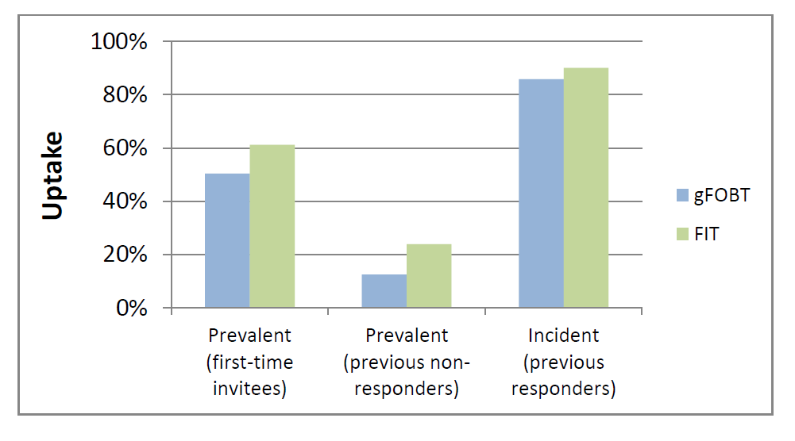
FOBT vs FIT
The low sensitivity and specificity of gFOBT testing has led to the NHS BCSP
complex three step screening process, each requiring six samples from three separate stools for a definitive positive result. This screening process results in lower uptake; particularly amongst disadvantaged groups, with
high drop-out of individuals at each step, thus potentially missing high risk individuals. In contrast, screening with FIT can be achieved using only one stool sample, which is easier to collect than when using gFOBT.

Slide 12
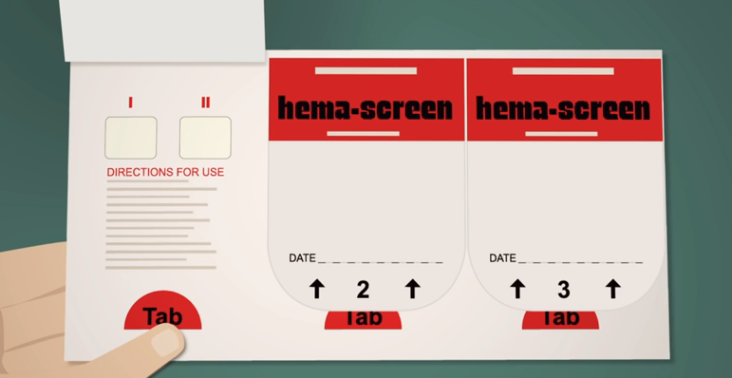
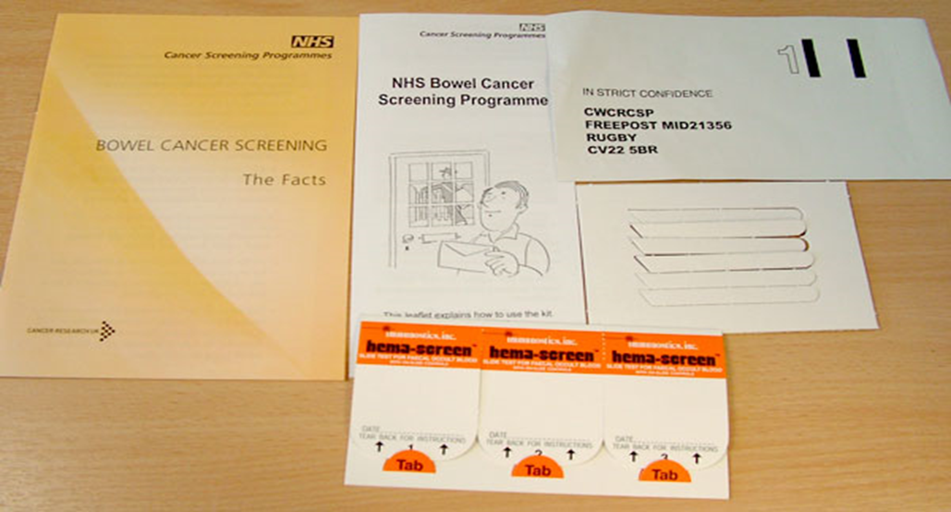
FOBT

Slide 13
FIT

Slide 14
Demand modelling and capacity planning

Slide 15
Planning Assumptions
Providers expected to be in a position to deliver FIT from December 2018 based on a 1 in n phased approach differentiated by hub or screening centre (details tbc)
Annual increase in number of invitations sent (c. 3% annually)
Increased response rate to FIT invitations (c. 7% average)
Positivity rate from pilots c. 2.12%
Bowel scope roll out plans remain unchanged for now
Demand for screening endoscopies will go up + path and radiology impact
Potential Additional growth within the surveillance cohort over an 8 year period with initial impacts expected in years 2 and 4 post roll out

Slide 16
Modelling

Slide 17
Activity Impact
Screening and Surveillance Colonoscopies With Expected Growth
Screening Centre | 2016/17 | 2017/18 | 2018/19 | 2019/20 | Increase (n) | Increase (%)
Cornwall | 384 | 384 | 440 | 704 | 320 | 83
N&E Devon | 331 | 333 | 390 | 696 | 365 | 110
Bristol | 490 | 472 | 557 | 831 | 341 | 70
Somerset | 375 | 362 | 445 | 705 | 330 | 88
South Devon | 421 | 425 | 503 | 851 | 430 | 102

Slide 18
Opportunities and Challenges

Slide 19
Opportunities
Better outcomes for patients with positive impacts on other parts of the cancer pathways
Whole system approach to capacity planning e.g. qFIT and symptomatic services. Shared outcomes
Training and development opportunities for staff involved in bowel screening
Opportunity for services to undertake an internal review of their capacity and operating models, look for productivity, quality and efficiency gains
Opportunity to revisit the funding formula and contract mechanisms with each provider
Financial investment available to pump prime FIT roll out
qFIT potential to unlock capacity???

Slide 20
Challenges
Accuracy of the modelling assumes parameters are robust and will occur. How can we plan for variance?
Limited modelling to date on impact on pathology and radiology (must not overlook this)
No immediate clarity on what phasing would look like from a hub perspective
Surveillance cohorts currently paid for by CCGs
Workforce, significant implications for some providers with ongoing training and recruitment planning
Additional equipment requirements and physical space to run additional lists that require capital funding
Diagnostics services in a number of providers already stretched and waiting times not being achieved especially in symptomatic services
Potential to create imbalance between screening and symptomatic services in terms of outcomes for patients
No national funding model or financial allocation for FIT
Most providers working to a population based funding formula with a block contract
qFIT impact could be negative????

Slide 21
Next steps

Slide 22
Next steps
Validating the capacity demands with providers, ensure we have captured and quantified all impacts, risk assessments to assure national oversight processes
Review provider mobilisation and investment plans, agree pump priming funding where suitable.
Agree contracts and pricing with screening centres for the additional expected activity
Critical dependency is the timing and outcome of the national procurement for the FIT testing kits, sample hardware and IT for the hubs to begin phasing the invitations
Continue to work with CCGs on whole pathway capacity plans to mitigate any unintended consequences from FIT120
Continue to work with stakeholders including Cancer Alliances to ensure clear and consistent messaging and identify any areas for complimentary work to improve patient outcomes

Slide 23
Thank you for listening…. Any questions?

