Slide 1
Gloucestershire Redesign of Urgent and Emergency Care
29th November 2018
1

Slide 2
Welcome
Candace Plouffe – Executive Lead for UTCs, Chief Operating Officer for Gloucestershire Care Services
Malcolm Gerald – Clinical Lead for the One Place Programme, GP
Maria Metherall - Senior Commissioning Manager: Urgent and Emergency Care.
2

Slide 3
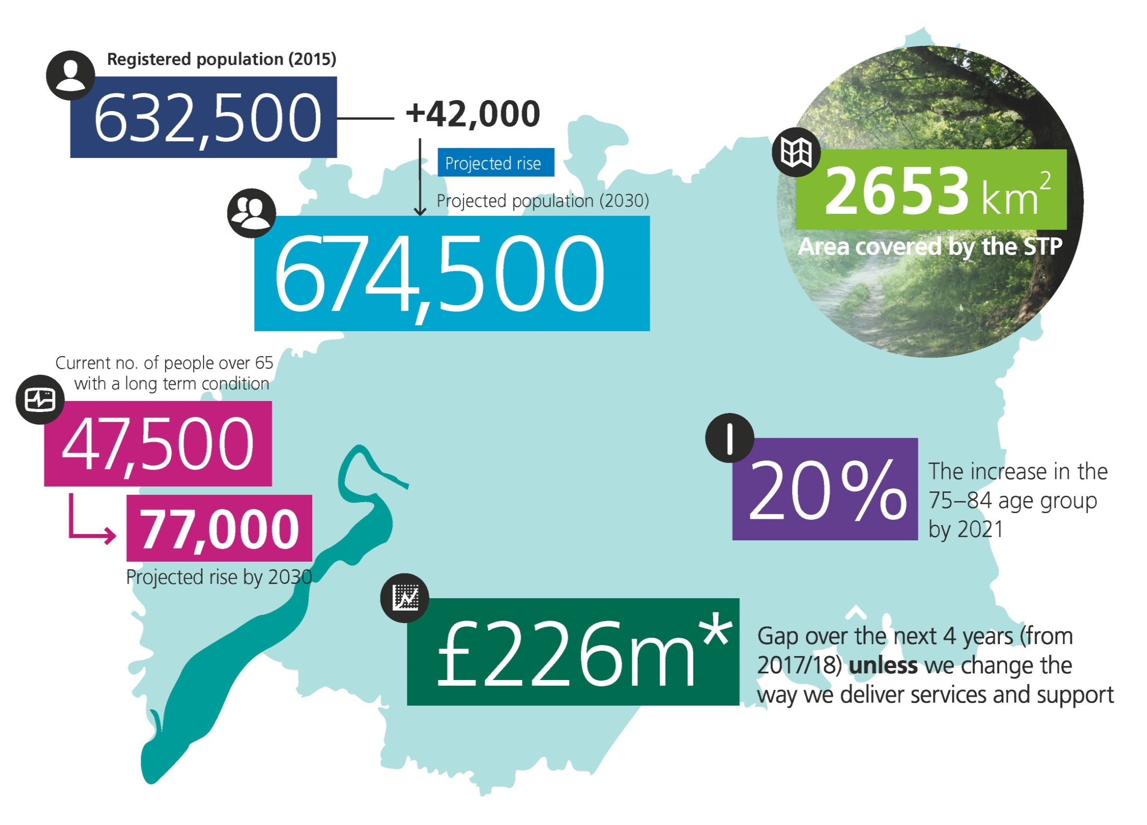
The scale of our challenge:
Notes:
Talk through current ED and MIIU arrangements

Slide 4
Our current provider landscape
Self Care and Prevention – ASAP, NHS 111 on line, Pharmacy First
NHS 111 – Care UK
Mental Health Contact Centre – 2Gether
Dental Access Centre – Gloucestershire Care Services
Single Point of Clinical Access – Gloucestershire Care Services
Out of Hours – Care UK
Mental Health Crisis Team – 2Gether
Minor Injuries and Illness Units based in our community hospitals – Gloucestershire Care Services
Emergency Departments in Gloucester and Cheltenham – GHFT
Mental Health Liaison Service – 2Gether
Integrated Discharge Team based in ED - GCS
Substance misuse service based in ED – Change Live Grow

Slide 5
Our approach
5

Slide 6
Our Vision
“Our vision for urgent and responsive care is that people with the most serious or life threatening emergency care needs will receive treatment in centres with the very best expertise and facilities in order to reduce risk and maximise chances of survival and good recovery.
For elective care, Centres of Excellence will ensure the highest clinical quality and constitution standards are met. For people with unplanned but non-life threatening needs we will provide highly responsive, effective and personalised services outside of hospital and deliver care in or as close to people’s homes as possible.”
This information is confidential. Proposals detailed within this document are subject to consultation/involvement
6

Slide 7
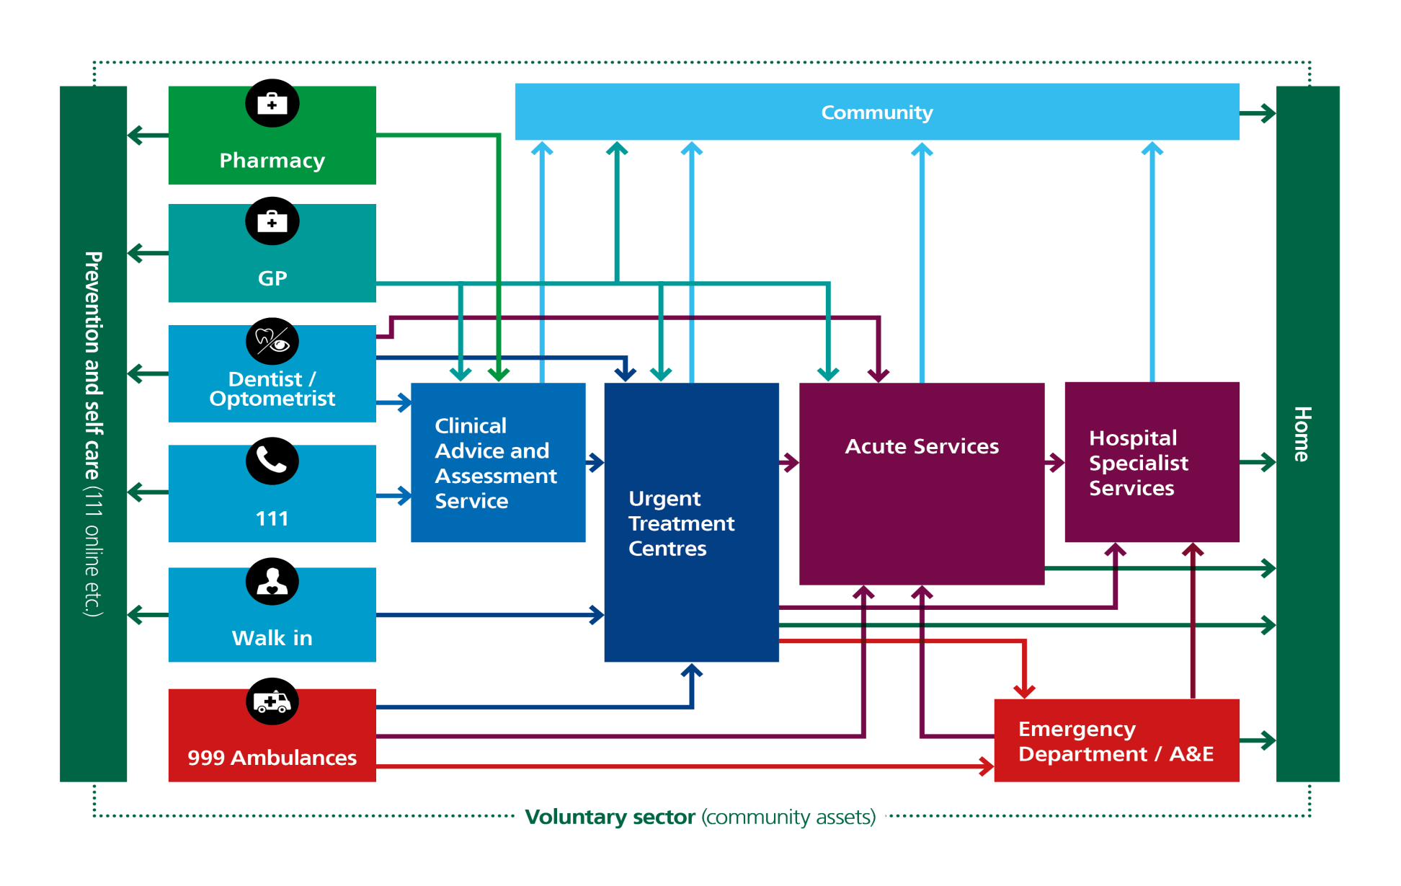
New Clinical Model

Slide 8
Our approach
Developed data packs for existing services – activity, workforce and costs
Reviewed the latest guidance and evidence
Gathered and reviewed patient feedback
Mapped out current pathways
Workshops to co-produce new pathways and workforce with clinicians and patients
Developed activity, workforce and finance models
Developed draft service specification and a commissioning strategy
Business case developed
Taking a test and learn approach to improve support during winter and test modelling assumptions whilst wider engagement, approval and public consultation is progressed

Slide 9
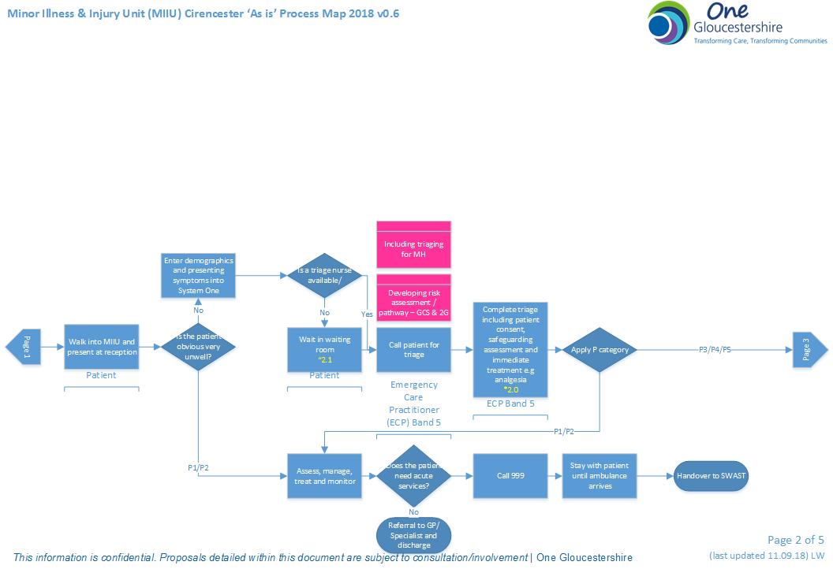
Mapped out current Pathways

Slide 10
Workshops
Everyone in the room is keen to work together to make UTCs work. Positive experience.
Felt like a ‘safe space’ in which to share.
People are willing to think differently
Much better knowledge of UTCs and the wider urgent care pathway
Good balance of presentations and interactive sessions. Good opportunity to network with lots of different people.
Good cross section of clinical roles, public attendance, walkthrough of current process

Slide 11
Activity, Workforce and Finance Modelling
‘As is’ Data Pack produced
Output from the workshop fed into an activity and workforce model
Workforce workshops to discuss skills mix and skills shortages, proposed model
A number of iterations
Information then costed for inclusion in the business case

Slide 12
Stakeholder Engagement
12

Slide 13
Stakeholder Engagement
STP Engagement asked for people who would like to get more involved to get in touch – these individuals have fed into the process
Involved in patient questionnaire design
Over 650 patient surveys completed and analysis produced
Workshops with strong clinician and patient representation
GP involvement at workshops and through specific locality sessions
Specific additional sessions on Mental Health across all of urgent care
There have been regular updates to HOSC
There have been regular updates and discussion at ICS Delivery Board and within organisational boards

Slide 14
Test and Learn
14

Slide 15
What are we testing?
UTCs (Elements in Cirencester, Gloucester & Cheltenham)
Being managed through a ‘Plan, Do, Study, Act’ (PDSA) approach that tests changes on a small scale, building from test cycles in a structured way before full-scale implementation.
Makes change safer and less disruptive to patients and staff and can be scaled up once concepts are robust.
Ten PDSA activities currently being implemented: six in Diagnostic Services in UTCs and four more general UTC operational processes.
Further PDSA activity planned for Clinical Advice and Assessment, Dental Services and Mental Health.

Slide 16
What are we testing?
Diagnostics
PDSA 1: Radiology and Nursing Staffing Model.
PDSA 2: X-Ray Extended Hours in a Rural Site.
PDSA 3: Direct Booking into Imaging Services.
PDSA 4: Urban Patient Appointments in Rural Sites.
PDSA 5: Providing Point-of-Care Testing in UTCs.
PDSA 6: Digital Solutions.
Non-Diagnostics UTC
PDSA 7: Direct Booking to UTCs.
PDSA 8: Integrated Reception.
PDSA 9: NHS 111 Phone Link in Reception.
PDSA 10: Booking Screen in Reception.

Slide 17
Next Steps
17

Slide 18
Next Steps
Feed test and learn outcomes into updated modelling
Update business case for ICS/Organisational Boards
NHSE/I Approval to proceed
HOSC oversight
Formal Consultation
Revise model based on public feedback
Develop full business case for ICS/Organisational Boards
HOSC oversight
Full implementation

