Slide 1
Strategy Update March 2019

Slide 2
Goals of the strategy
This strategy aims to equip individuals within our community with the knowledge, resources, and confidence to:
1. Be an empowered community who deliver a mental wealth culture
2. Reduce factors associated with mental ill health
3. Provide & signpost to effective and timely provision for those who need support
The key principles of the strategy:
Whole institution approach
Effectively communicated
Local and national partnerships
Data and evidence driven
PROMOTION
PREVENTION
PROVISION

Slide 3
Where do we want to be?
The MENTAL WEALTH vision
How will we do it?
The activities
What does that mean?
The goal (s)
Mental wealth is a whole-institution approach to build positive wellbeing in individuals and in our community.
This strategy aims to create an empowered culture where mental wealth is embedded through all strands of university life.
This strategy aims to equip individuals within our community with knowledge, resources, and confidence to:
1. Be an empowered community who deliver a mental wealth culture
2. Reduce factors associated with mental ill health
3. Provide & signpost to effective and timely provision for those who need support
COMMUNICATIONS
PLAN
PROMOTION
PREVENTION
Full audit & roll out of staff mental health training and support
PROVISION
Physical provision: - Diversify Wellbeing service with Nilaari
- Pilot Managing Me - Establish out of hours team
- Open new Student Centre for 24/7 provision
Promote Resilient U programme & PAL mentors for peer support
Run awareness campaigns: #LetsTalkNow
Publish Feel Good Focuses & run Feel Good February, under strategic direction from Mental Wealth steer
Create one stop signposting to services
Develop and embed emotional resilience in the curriculum
Consider curriculum design – review all programmes
Use Learner Analytics to increase student insight
Design student mental health module
Develop the UWE App
Run a parent & carer advice section on website & send out newsletter
Improve staff recruitment and induction materials with mental wealth focus
Digital provision: - Launch CBT programme - Promote Kooth - Launch partnership with Crisis Text Line
WIDER PREVENTION INTERVENTIONS
Drugs– devise new drug policy & stricter action regarding impact on others
Campus services – collaborative approach on issues of conduct, wellbeing & drugs
Alcohol impact – run social norms campaigns & alcohol free events
Enhanced training for CSO’s
Run anti drug campaign across all campuses
Create short video on drugs, risks, and discipline
Create clear provision map and ensure it is effectively communicated
Create online triage tool to direct to relevant support services
Pilot social prescribing referral programmes: exercise, music, gardening/outdoors
Focus on transitions into HE through working group, Thrive network, and Future Quest
Promote student and staff participation in university life
Signpost effectively to external services
Wellbeing promotion & raising awareness
Programmes, interventions & embedding
Support services

Slide 4
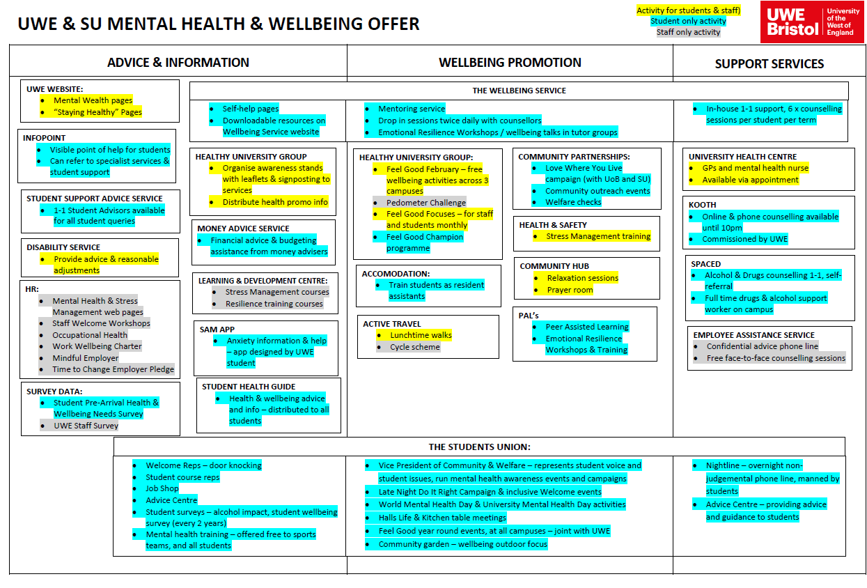
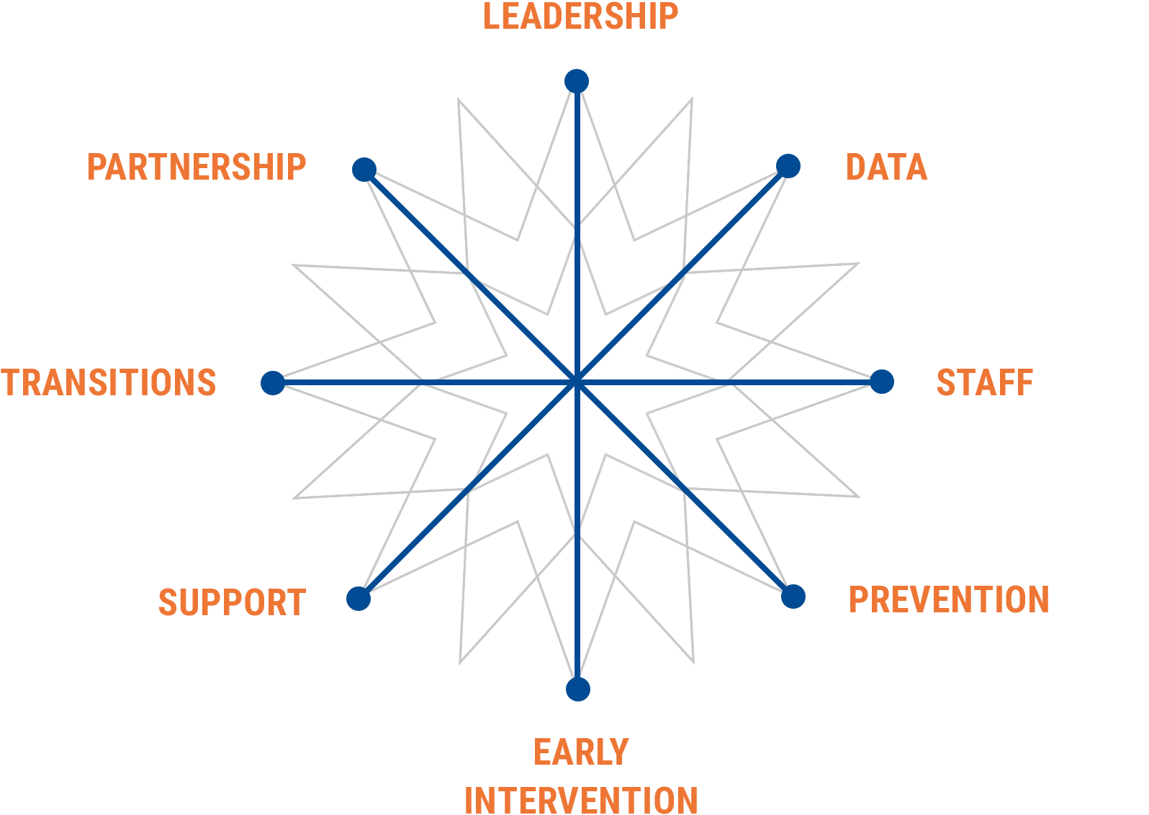
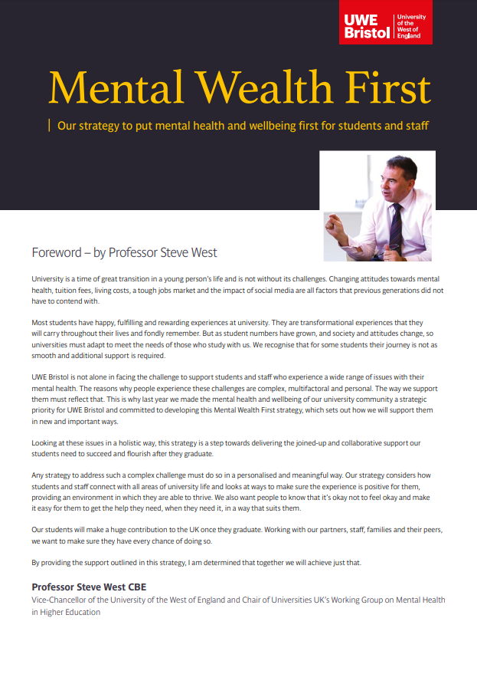
Mental Wealth: Timeline Recap
January 2018
UUK Step Change Framework provides structure & initial audit carried out
April 2018
Strategy Launch
Launch event in FBL & initial strategy document published
August 2018
Provision map made with all key mental health activity and services across UWE
October 2018
Strategy Workshop with key stakeholders to create strategy goals & next phase of work
December 2018
Feedback Forum held with students to get insight & feedback into service offer
January 2019
New strategy goals announced for next 12 months
Work begins to map benefits, create evaluation methods, and forecast next 10 years of strategy…
1. Be an empowered community who deliver a mental wealth culture
2. Reduce factors associated with mental ill health
3. Provide & signpost to effective and timely provision for those who need support
PROMOTION

Slide 5
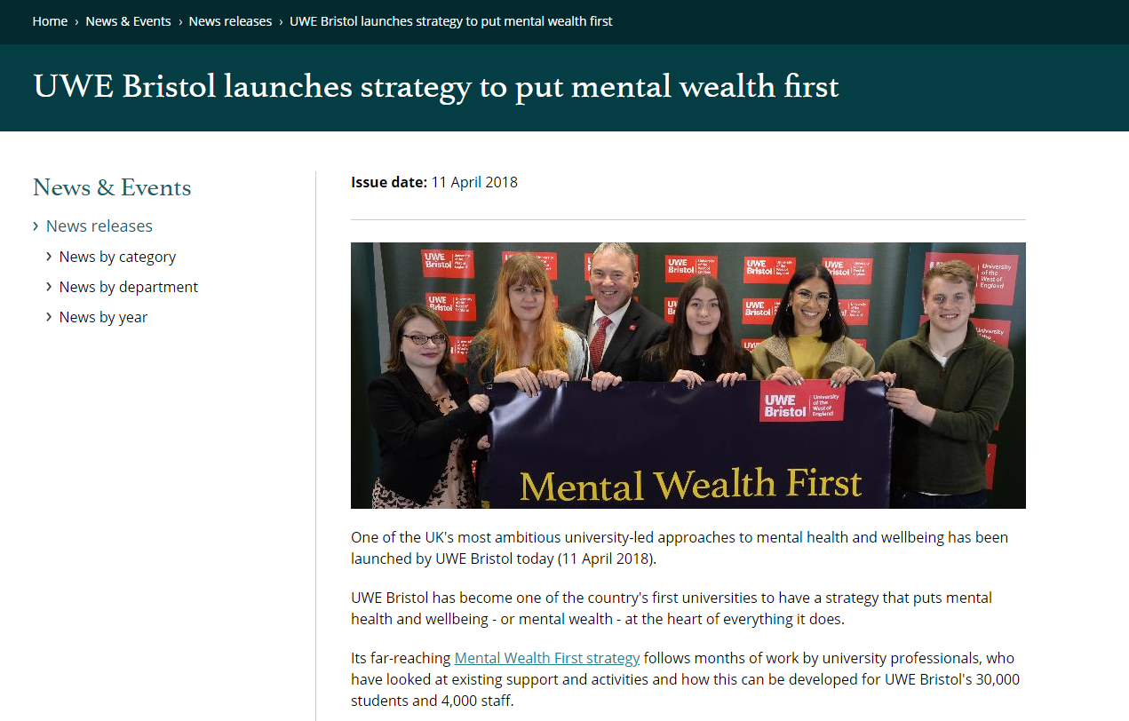
Progress so far
PROMOTION
High profile milestones:
Mental Wealth videos with students’ stories – over 20,000 views online
Hosting the Universities minister at UWE Bristol for a roundtable discussion

Slide 6
Progress so far
PROMOTION
Starting the conversation:
#LetsTalkNow campaign to breakdown stigma
New parent & carer advice section launched on website
Student Health Guide published September 2018
Student newspaper – published September 2018 for Welcome Week

Slide 7
Progress so far
PROVISION
Improving campus support provision:
24-hour Farmhouse Student Centre is now open on campus as a relaxing wellbeing space
New Out-of-Hours team provide evening and weekend support on campus
New Substance Abuse Support Worker on campus as part of the Wellbeing Service

Slide 8
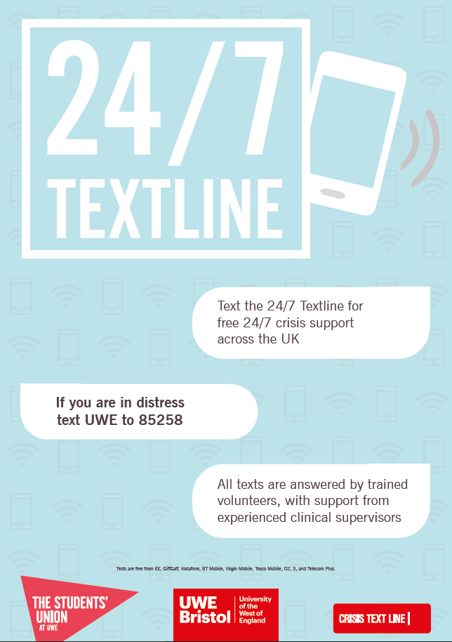
Progress so far
PROVISION
Improving digital support provision:
24/7 crisis text line service launched for students – the first in the country
Online CBT training launched
Development of the UWE app for students
Ongoing partnership work with the SAM App

Slide 9
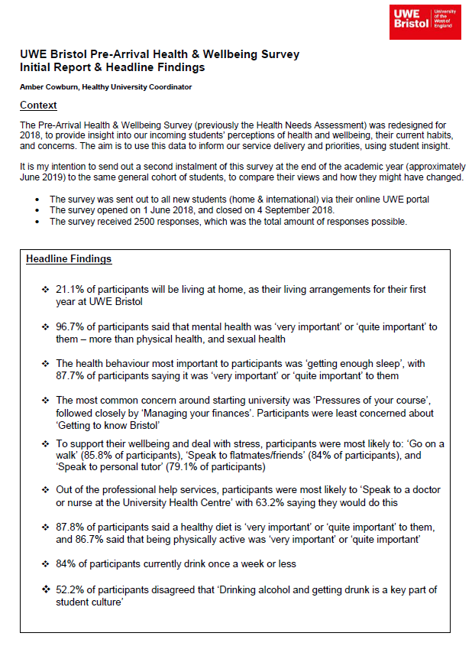
Progress so far
PREVENTION
New data insights:
Pre-Arrival Health & Wellbeing Survey had 2500 responses about students’ priorities & concerns – used to shape projects
The Wellbeing Service now recording more sophisticated data to more easily identify trends and patterns

Slide 10
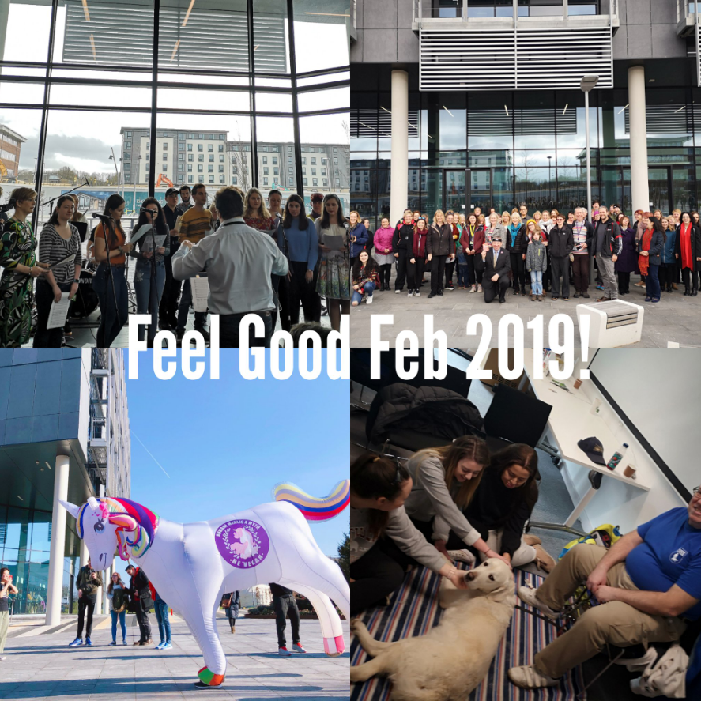
Progress so far
PROMOTION
Wellbeing events:
Feel Good February 2019 4 wellbeing themes Over 1500 students & staff participated
Partnership with Bristol’s first wellbeing festival, Wild & Well
World Mental Health Day (October) & University Mental Health Day (March) marked with a programme of events

Slide 11
Progress so far
PREVENTION
Staff training:
All staff training announcement to complete the Charlie Waller Memorial Trust online modules on ‘Supporting Student Mental Health and Wellbeing’
HR appointed 6 month post to audit & review further staff training needs in mental health awareness
Mental health component also now being delivered in programme leaders training

Slide 12
Phase 2: January – December 2019

Slide 13
Student support - the vision
Moving away from the traditional model which focused entirely on the Wellbeing Service
Transitioning to a “landscape” provision which means a dynamic & diverse support offer for students
The student support offer combines a range of in-person & digital support
Daily ‘Farmhouse drop-ins’ – coffee morning for students with concerns, staffed by multi-agency student support
The aim of the student support offer is to enable students to succeed

Slide 14
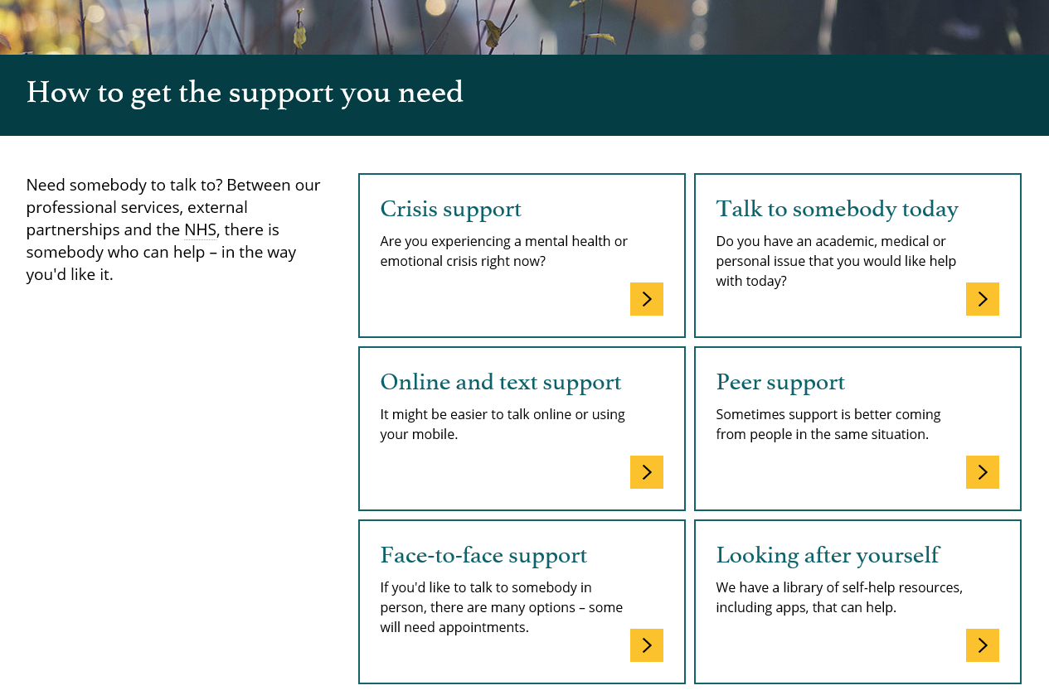
Student support - the vision
The student support offer is all on a single webpage with the direct URL: www.uwe.ac.uk/wellbeing - the support is categorised based on need level
The student support offer will be promoted via a joint UWE & SU poster campaign that links directly to the webpage, and a UWE wellbeing services leaflet

Slide 15
Key actions Jan – Dec 2019
Launch new model mapping mental health provision at UWE – including physical and digital. Signposting from all UWE services using same service map.
Run year-round communications programme of mental health service offer to students & staff – marketed through all channels, across all campuses.
Online triage tool for students or staff to find appropriate services.
Launch of CBT online training for students.
Creation of new start-of-year student induction materials, including induction video, student health guide and newsletter for parents.
#LetsTalkNow awareness raising communications campaign at key times of the year to tackle the stigma associated with mental health issues.

Slide 16
Key actions Jan – Dec 2019
Completion of staff training & staff support audit, and rollout of new model begins.
Feel Good February – rebranded and redirected under Mental Wealth focus, featuring a month-long programme of events, activities and advice. Supported by monthly Feelgood Focus.
Launch of social prescribing pilots: exercise, music, gardening – referrals from wellbeing service & self-referral.
Development of drugs & alcohol risks communications campaign in partnership with the SU at UWE.
Creation of student and staff mental health champions.
Internal data sharing developments to improve understanding of student and staff mental health and service usage.
Campus services approach – a collaborative & consistent approach on campus in response to issues of wellbeing, drugs, or conduct.
Launch of Mental Wealth Lab – programme of speakers and discussion.

Slide 17
Progress of 2019 actions – March Update
 | ACTION | March 2019 Update
1 | Launch new model mapping mental health provision at UWE – including physical and digital. Signposting from all UWE services using same service map. | New UWE wellbeing webpages up, with direct URL New UWE wellbeing support leaflet to match webpages Poster created with all support options – roll-out in April
2 | Run year-round communications programme of mental health service offer to students & staff – marketed through all channels, across all campuses. | Communications plan in place Extensive comms around Feel Good February Lets Talk Now podcast – launch in April
3 | Online triage tool for students or staff to find appropriate services. | New UWE wellbeing webpages up, with direct URL – that categorise services as a triage approach
4 | Launch of CBT online training for students. | Online provider secured and tested Launch in March
5 | Creation of new start-of-year student induction materials, including induction video, student health guide and newsletter for parents. | Comms team working on 3 induction video concepts: wellbeing induction, course induction, accommodation induction To be launched in September 2019

Slide 18
Progress of 2019 actions – March Update
 | ACTION | March 2019 Update
6 | #LetsTalkNow awareness raising communications campaign at key times of the year to tackle the stigma associated with mental health issues. | Lets Talk Now podcast – launch in April Post-it campaign due to be relaunched in exam time Feel Good de-stress campaign to launch in exam time
7 | Completion of staff training audit, and rollout of new mental health awareness training model. | Charlie Waller Memorial Trust training modules rolled out to all staff Evaluation to follow HR continue audit on staff training needs OFS Bid in for large training programme for Bristol FE
8 | Feel Good February – rebranded and redirected under Mental Wealth focus, featuring a month-long programme of events, activities and advice. | Over 1500 students & staff took part Full evaluation on Frenchay campus 4 key themes with clearer link to Mental Wealth
9 | Launch of social prescribing pilots: exercise, music, gardening – referrals from wellbeing service & self-referral. | Exercise wellbeing referral pilot is live, with referrals coming from wellbeing service Gardening & music are being scoped to start in September

Slide 19
Progress of 2019 actions – March update
 | ACTION | MARCH 2019 Update
10 | Development of drugs & alcohol risks communications campaign in partnership with the SU at UWE. | Currently being researched & scoped by the UWE comms team
11 | Creation of student and staff mental health champions. | Being scoped with 200 SU student reps to brief them on mental wealth & signposting, and to develop Student Mental Wealth Communications Advisory Group
12 | Internal data sharing developments to improve understanding of student and staff mental health and service usage. | Larger pieces of work on Connected Delivery, and Student Analytics Wellbeing Service now collecting more advanced data Pre-Arrival Health & Wellbeing Survey will be followed up
13 | Campus services approach – a collaborative & consistent approach on campus in response to issues of wellbeing, drugs, or conduct. | Campus services approach has been devised Campus services will receive specific training
14 | Launch of Mental Wealth Lab – programme of speakers and discussion. | First event will be in May Mental Wealth Lab will include a fund students and staff can bid for, for mental health projects & events

