Slide 1
New Developments in: evidence and guidance for suicide prevention at transition from school to further and higher education
November 2017

Slide 2
Report on Child Suicide 2017
http://research.bmh.manchester.ac.uk/cmhs/topicalatozlist/suicide_by_children_and_young_people/

Slide 3
Key Findings

Slide 4
Key Findings (2)

Slide 5
All PHE suicide prevention resources and guidance can be accessed here:
https://www.gov.uk/government/collections/suicide-prevention-resources-and-guidance#history

Slide 6
Risk factors: Self harm
https://www.gov.uk/government/uploads/system/uploads/attachment_data/file/621068/Health_behaviour_in_school_age_children_self-harm.pdf
For the masterclass report contact jan.bond@phe.gov.uk

Slide 7
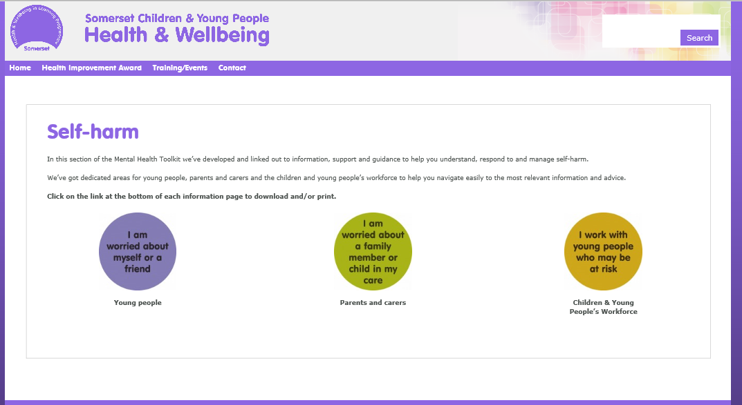
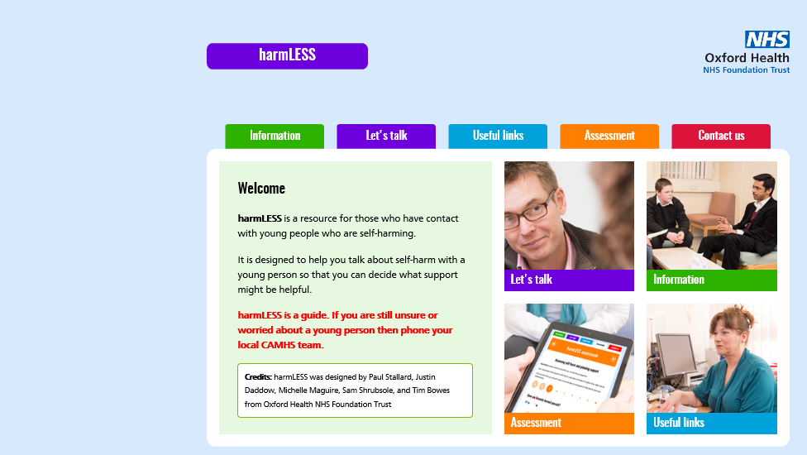
Self harm resources online
http://www.cypsomersethealth.org/sh
https://www.oxfordhealth.nhs.uk/harmless/
Notes:
http://www.cypsomersethealth.org/sh
https://www.oxfordhealth.nhs.uk/harmless/

Slide 8
Risk factors: cyber bullying
https://www.gov.uk/government/uploads/system/uploads/attachment_data/file/621070/Health_behaviour_in_school_age_children_cyberbullying.pdf

Slide 9
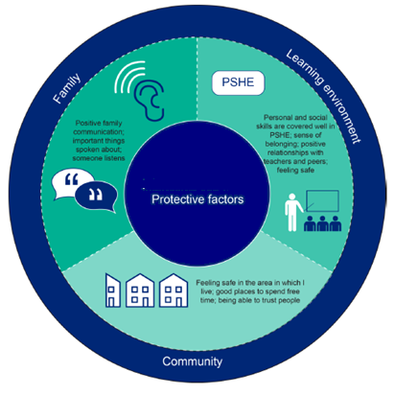
Protective factors: self-harm and cyberbullying
https://www.gov.uk/government/uploads/system/uploads/attachment_data/file/621068/Health_behaviour_in_school_age_children_self-harm.pdf
https://www.gov.uk/government/uploads/system/uploads/attachment_data/file/621070/Health_behaviour_in_school_age_children_cyberbullying.pdf
Notes:
https://www.gov.uk/government/uploads/system/uploads/attachment_data/file/621068/Health_behaviour_in_school_age_children_self-harm.pdf
https://www.gov.uk/government/uploads/system/uploads/attachment_data/file/621070/Health_behaviour_in_school_age_children_cyberbullying.pdf

Slide 10
Rise Above
https://campaignresources.phe.gov.uk/schools/topics/rise-above/overview

Slide 11
Online safety resources

Slide 12
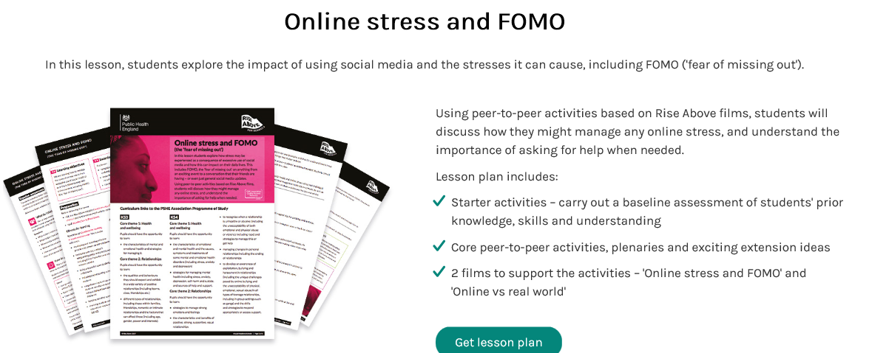
Rise Above resources

Slide 13
Housing

Slide 14
NHS Commissioning

Slide 16
For further information and guidance go to:
https://www.england.nhs.uk/wp-content/uploads/2016/11/cquin-2017-19-guidance.pdf

Slide 17
Vocational training and occupational risk: a steep social gradient
Three key factors
Job-related features such as low pay and low job security increase risk
People at high risk of suicide may selectively go into particular kinds of occupations
Having access to, or knowledge of, a method of suicide increases risk
https://www.ons.gov.uk/peoplepopulationandcommunity/birthsdeathsandmarriages/deaths/articles/suicidebyoccupation/england2011to2015#why-do-some-occupations-have-a-high-risk-of-suicide

Slide 18
Occupational risk: low skill and skilled trades
Males working in the lowest-skilled occupations had a 44% higher risk of suicide than the male national average; the risk among males in skilled trades was 35% higher.⬆
The risk of suicide among low-skilled male labourers, particularly those working in construction roles, was 3 times higher than the male national average.⬆⬆⬆
For males working in skilled trades, the highest risk was among building finishing trades; particularly, plasterers and painters and decorators had more than double the risk of suicide than the male national average.⬆⬆

Slide 19
Occupational risk: health and education
.
Male and female carers had a risk of suicide that was almost twice the national average.⬆⬆
For females, the risk of suicide among health professionals was 24% higher than the female national average; this is largely explained by high suicide risk among female nurses.⬆
Females within the teaching and education profession had a lower risk⬇ of suicide but specifically for primary and nursery schoolteachers there was evidence of an elevated risk.⬆

Slide 20
Occupational risk: culture media and sport managers directors and senior officials
The risk of suicide was elevated for those in culture, media and sport occupations for males (20% higher than the male average) and females (69% higher); risk was highest among those working in artistic, literary and media occupations ⬆
Individuals working in roles as managers, directors and senior officials – the highest paid occupation group – had the lowest risk of suicide. Among corporate managers and directors the risk of suicide was more than 70% lower for both sexes⬇

Slide 21
College Settings
https://www.aoc.co.uk/sites/default/files/AoC%20College%20Key%20Facts%20201718%20%28web%29.pdf
Notes:
https://www.aoc.co.uk/sites/default/files/AoC%20College%20Key%20Facts%20201718%20%28web%29.pdf

Slide 22
Association of Colleges Resource Pack
https://www.aoc.co.uk/sites/default/files/Supporting%20Student%20Mental%20Health%20and%20Wellbeing%20in%20Colleges%20-%20A%20Resource%20Pack_0.pdf
Notes:
https://www.aoc.co.uk/sites/default/files/Supporting%20Student%20Mental%20Health%20and%20Wellbeing%20in%20Colleges%20-%20A%20Resource%20Pack_0.pdf

Slide 23
Self Assessment Tool
Leadership and Management
Ethos and Environment
Curriculum
Student voice
Staff development and support
Targeted support
Parents and carers
External partnerships
Audit and evaluation
Set of case studies and guide to further resources

Slide 24
Not by Degrees: Improving student mental health in the UK’s universities
https://www.ippr.org/research/publications/not-by-degrees

Slide 25
Not by Degrees: key Findings:
Today’s generation of young adults – and particularly young women are more likely to experience mental illness than previous generations.
The number of students who disclose a mental health condition to their university has increased dramatically in the past 10 years.
Where support and treatment is lacking, poor mental health can lead to increased risk of students dropping out of university, or in the most severe and tragic cases, death by suicide.
Universities have, over the past five years, experienced significant increases in demand for counselling and disability services.
There is variation in the ways in which universities design their strategic response to student mental health and wellbeing.

Slide 26
Universities UK- #stepchange
Since 2002, Universities UK (UUK) has hosted a standing group on Mental Wellbeing in Higher Education
UUK adopted mental health as a proactive policy priority in 2016, launching the programme to improve the mental health of students and staff across higher education. Public Health England has provided funding to support this work. The Mental Wellbeing Working group is chaired by Steve West from the University of the West of England and includes a GP from the University of Bristol Student Health Service and members of PHE national mental health team.
http://www.universitiesuk.ac.uk/policy-and-analysis/stepchange/Pages/default.aspx

Slide 27
#stepchange

Slide 28
#stepchange: Whole University Approach

Slide 29
#stepchange Framework

Slide 31
Whole school/college additional resources
https://www.gov.uk/government/publications/health-and-work-infographics
https://wellbeing.bitc.org.uk/sites/default/files/business_in_the_community_suicide_prevention_toolkit_0.pdf

Slide 32
Jan Bond
Health and Wellbeing Programme Manager
Perinatal, Children and Young People’s Mental Health
Public Health England South West,
Jan.bond@phe.gov.uk

